Slide 1

System Proposal Edenbridge scheduling & time-tracking dbms
December 11th, 2019

Slide 2
Agenda
Team & Client Introduction
Feasibility
Summary & Recommendation
Proposed System – Components
Proposed System – Data Flow Diagrams
Proposed System – Entity Relationship Diagrams
Notes:
Aidan

Slide 3
Team & Client Introduction
ITI Solutions
Edenbridge Family Services
Notes:
Aidan

Slide 4
Who We Are
ITI Solutions
We are a group of college students utilizing the skills we have learned over our academic career to design, build and implement systems. We value quality and work in a team-oriented environment in order to achieve maximal efficiency.
Achieve Maximal Efficiency
Notes:
Aidan

Slide 5
Our Team
ITI Solutions
Aidan C. | Team Leader & Database Designer
Harley L. | Liaison Officer & Programmer
Justin A. | Database Developer
Beryon C. | Server Engineer & User Experience
Evan G. | Programmer & User Experience
Notes:
Everyone

Slide 6

Our client
Organization that provides services for people that require special assistance
Government/privately funded organization
Notes:
Aidan

Slide 7
Current system
Edenbridge has several coordinators that schedule workers for a bimonthly period
Information about shifts is stored in multiple binders in the office
Workers are informed about their shifts over the phone
Workers bring in a paper timesheet to report the hours they worked
The information from these timesheets is manually entered into an Excel spreadsheet
Notes:
Aidan

Slide 8
Business problem
Edenbridge’s group home workers have complex rules for scheduling and time tracking
With multiple binders between departments to store shifts in it easy to book a worker for overtime
When shifts are rescheduled it can cause errors in the time tracking
With 200+ workers it can be difficult to find errors in a time- effective way on the current system.
The process of entering data is time consuming
Notes:
Aidan

Slide 9
Feasibility
Comparisons
In-House Development
Custom Development
Off-The-Shelf System
Recommendation
Notes:
Harley

Slide 10
system Feasibility – off-the-shelf
Technical Feasibility
Off the shelf systems are usually designed to be compatible with a wide range of technologies to reach the most customers possible.
Economic Feasibility
Off the shelf is usually a cheap solution as a result of being a one-size-fits-all generic implementation.
Organizational Feasibility
As far as integrating an off-the-shelf system into the organization is concerned it is likely not be the best option as it may not have all functions required.
Notes:
Main Bulk: Harley
Extra information: Beryon
Deputy
- Pros: Good UI, auto-rescheduling to other workers, decent pricing ($1270/month to Edenbridge w/ support), good organization
- Cons: Shifts are coded to a category, does not accommodate the multiple shift types per shift Edenbridge requires.
shiftboard
- Pros:
- Cons:

Slide 11
System Feasibility – in-house
Technical Feasibility
The employees at Edenbridge are not familiar with information system development and would have to go through extensive training to develop it.
Economic Feasibility
This option would be excessively expensive from having to train the employees and having them working on the project instead of performing their normal duties.
Organizational Feasibility
It would likely be easy to integrate into the company as it would hopefully be made exactly how they want it to be.
Notes:
Harley

Slide 12
System Feasibility - custom
Technical Feasibility
All the required hardware is present at Edenbridge
As a development team, we have the skills to build the program, so the system is technically feasible
Economic Feasibility
Usually, the cost for a custom system would be expensive
As we would be developing the system as a project for our program, there will be no development costs
Organizational Feasibility
The system is developed and tailored to the organization, so it would be feasible for the organization to implement the custom system
Notes:
Harley

Slide 13
Feasibility – cost comparison
 | In-House | Custom | Off-the-Shelf
Cost /10 | Developers are already working for the company, costs will not be as high as custom development Will still be more expensive than off-the-shelf Value: 6/10 | Hiring professional developers will cost more than in-house development or something prebuilt As the development of the system is a part of our course, there will be minimal development costs Value: 10/10 | Off-the-shelf systems will have lower cost because the system is made to be generic Value: 7/10
Notes:
Harley

Slide 14
Feasibility – time Comparison
 | In-House | Custom | Off-the-Shelf
Time /10 | In-house development usually takes longer, employees still have other work to do Value: 3/10 | Professional development usually takes less time than in-house, but longer than off-the-shelf Value: 8/10 | Has almost zero development time Customization can take a long time depending on complexity Value: 10/10
Notes:
Harley

Slide 15
Feasibility – Quality Comparison
 | In-House | Custom | Off-the-Shelf
Quality /10 | If the team in-house is not trained, the quality will be much lower than something professional Value: 3/10 | Professional custom solutions will be of higher quality and cohesiveness than either of the two other methods Value: 10/10 | Usually good quality but designed to be generic Does not work as well as something custom-made Value: 8/10
Notes:
Harley

Slide 16
Feasibility – Overall Comparison
 | In-House | Custom | Off-the-Shelf
Overall | Cost would be reasonable, not very cheap Long development time Quality dependent on employees Total: 12/30 | Usually costs the most but this is a college project, so we are doing it for free Reasonable development time Best fit for the business Value: 28/30 | Typically the least expensive option Can be implemented quickly Decent quality, needs customization to fit the specific business needs Value: 25/30
Notes:
Harley

Slide 17
recommendation
Overall recommendation goes to custom development of a system
Highest quality, cohesiveness with existing infrastructure
In this specific case it offers the lowest cost
Extended timeframe in exchange for higher degree of communication during development.
Notes:
Harley

Slide 18
Proposed System
Overview
Scope
Timeline
Budget
Notes:
Harley

Slide 19
System Overview
The system we are proposing has two major underlying components:
Scheduling
Time Tracking
Most everything managed by a web interface.
Versatile enough to handle a wide variety of circumstances related to rescheduling
Notes:
Harley

Slide 20
Project Scope – Scheduling
We will be providing an interface for the coordinators
It will also allow them to create and provide the employees with the schedules
Notes:
Harley

Slide 21
Project Scope – Shift Tracking
The employees will be notified about their schedule and provided with the details
The employees will have the ability to submit hour forms
The system will alert bookkeepers about errors/conflicts that are present
Automatic verification of data will allow most issues to be resolved prior to the completion of payroll
Notes:
Harley

Slide 22
Project scope – Users
The main users are coordinators and bookkeepers
Users for the new system will also include employees
Notes:
Harley

Slide 23
Project Budget
Description | Quantity | Unit Price | Total without service plan | Total with service plan
Hours | 105 | $100 | $15,000
Optional Service Plan | 1 | $1,500 |  | $16,500
Notes:
Harley

Slide 24
Project Timeline
Section Name | Start Date | End Date
Database Finalization | January 6th | January 31st
General Design | February 1st | February 14th
Implementation | February 15th | March 20th
Training | March 21st | April 1st
Delivery | April 2nd | April 22nd
Notes:
Beryon

Slide 25
Project Timeline
Section Name | Associated Tasks
Database Finalization | Verify structure of database Establish backup & restoration plan
General Design | Design user interface Design process flow
Implementation | Program interface Implement database Test components for reliability
Training | Establish training process Generate materials to supplement training
Delivery | Establish installation plan Install system & ensure operability Train on-site staff & provide documentation, other required materials
Notes:
Beryon

Slide 26
Expected Benefits
Error reduction
Greater efficiency
Reduced confusion
Centralization of information
Notes:
Beryon

Slide 27
Proposed System – Components
Front End & Middle-ware
Back End
Notes:
Beryon

Slide 28
Front end
The website is being hosted by A2 Hosting in the subdomain schedule.edenbridge.ca
The pages will be written in HTML, the style of the site will be achieved with CSS, we may utilize Bootstrap for greater efficiency
The middleware providing functionality to the system will be written in PHP and Javascript
Middleware
Notes:
Beryon

Slide 29
Database
MySQL server will be utilized
We will have a database with the Client, Employee, and Shift information
There will be a separate database for the application’s user information
Notes:
Beryon

Slide 30
Proposed System – Data-Flow Diagrams
Context Diagram
Level 0 Diagram
Level 1 Diagrams
Use Cases
Notes:
Evan

Slide 31
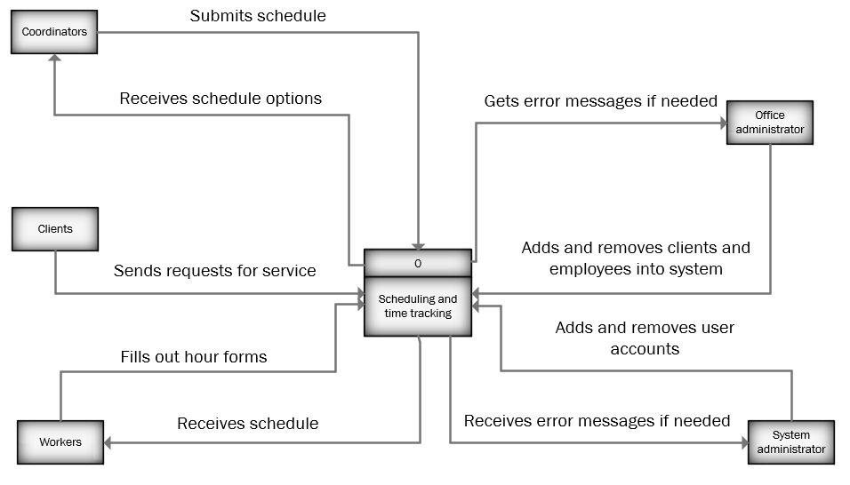
Context diagram
Notes:
Evan

Slide 32
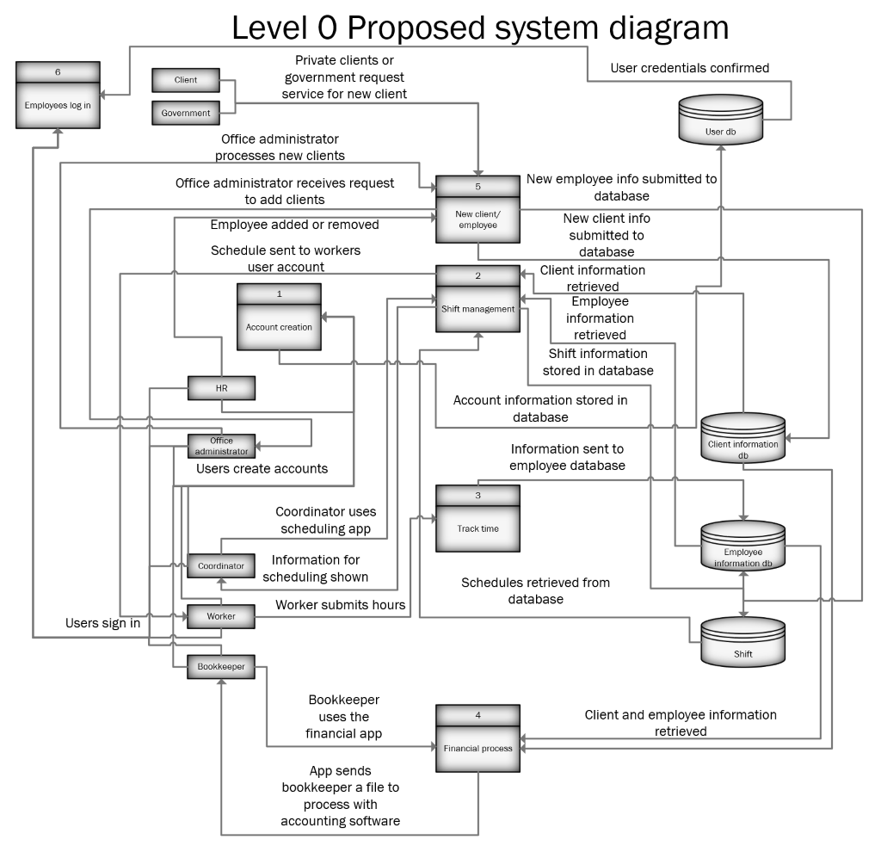
proposed system Diagram
Notes:
Evan

Slide 33
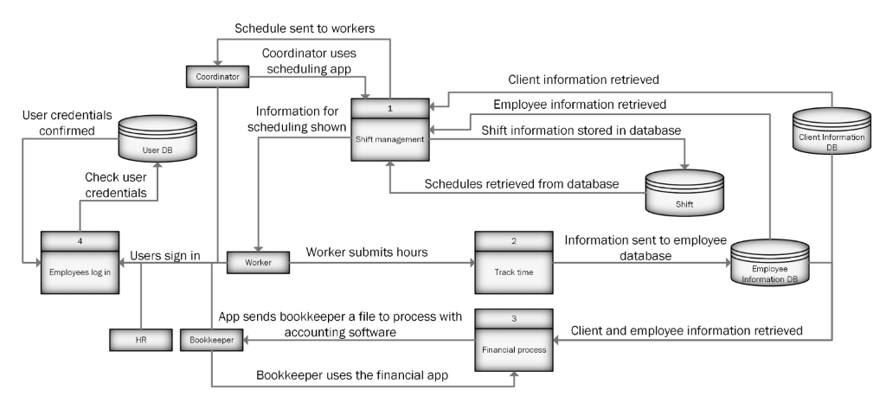
Simplified data flow diagram
Notes:
Evan

Slide 34
Processes
Scheduling
Time Tracking
Financial Processes
Client Creation
User Login
Notes:
Evan

Slide 35
Proposed System – Entity Relationship Diagrams
ERD Overview
Tables
Example Data
Notes:
Justin

Slide 36
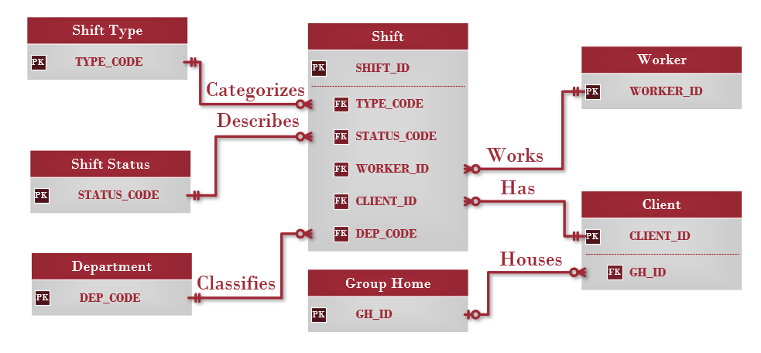
Entity Relationships
Notes:
Justin

Slide 37
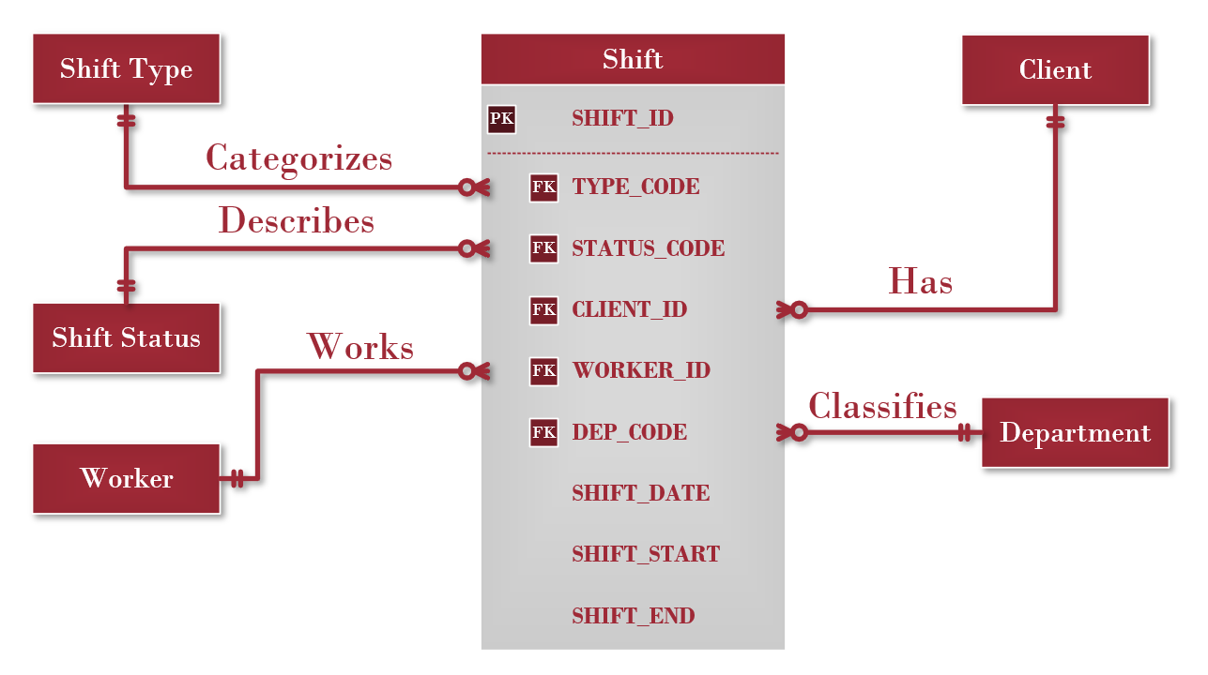
Shift Table
Notes:
Justin
Most important table, system is based on it
Linked to other tables, allow program to retrieve data about worker, client, etc.

Slide 38
Shift Table – Rules and Data
SHIFT_ID | TYPE_CODE | CLIENT_ID | WORKER_ID | DEPT_CODE
1 | GHD | 25 | 3 | GH
2 | INT | 52 | 87 | PDO
STATUS_CODE | SHIFT_DATE | SHIFT_START | SHIFT_END
C | 12/11/2019 | 13:00 | 18:00
S | 1/3/2020 | 8:00 | 12:00
Many shifts can be for one client
Many shifts can be worked by one worker
Many shifts can be categorized by one shift type
Many shifts can by classified into one department
Many shifts can be described by one shift status
Notes:
Justin

Slide 39
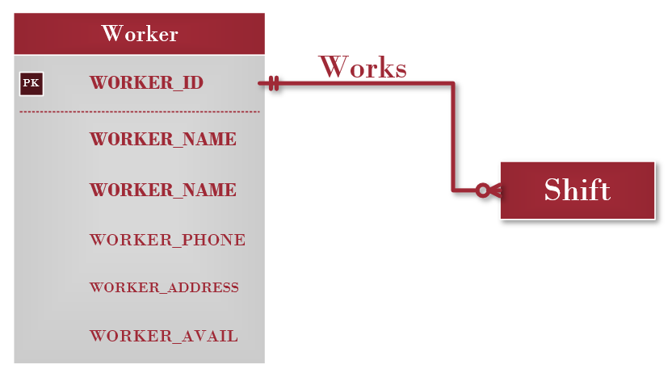
Worker table
Notes:
Justin

Slide 40
Worker table – Rules and Data
WORKER_ID | WORKER_NAME | WORKER_ADDRESS | WORKER_PHONE | WORKER_AVAIL
1 | Bob | 123 Some St. | Xxx-xxx-xxxx | Wed,8:00-23:00;
2 | Jim | 456 Another St. | Xxx-xxx-xxxx | Tus,4:00-20:00;
One worker can work many shifts
One shift is worked by one worker
Notes:
Justin

Slide 41
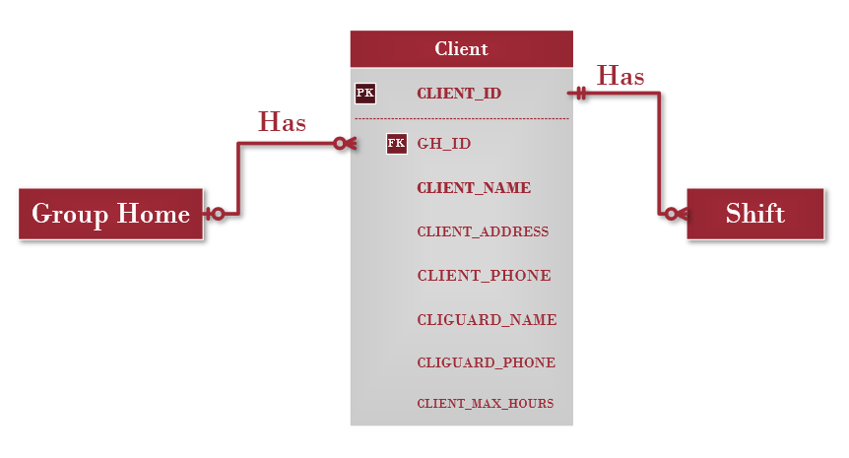
Client table
Notes:
Justin

Slide 42
Client table – Rules and Data
CLIENT_ID | GH_ID | CLIENT_NAME | CLIENT_ADDRESS | CLIENT_PHONE
1 | 1 | Clarkson | 123 Sample St. | Xxx-xxx-xxxx
2 | 0 | McDonald | 456 another St. | Xxx-xxx-xxxx
CLIGUARD_NAME | CLIGUARD_PHONE | CLIENT_MAX_HOURS
Tom | Xxx-xxx-xxxx | 20
Jorge | Xxx-xxx-xxxx | 15
One client can have many shifts
One shift is for one client
Many clients can live in one group home
One client lives in one group home
Notes:
Justin

Slide 43
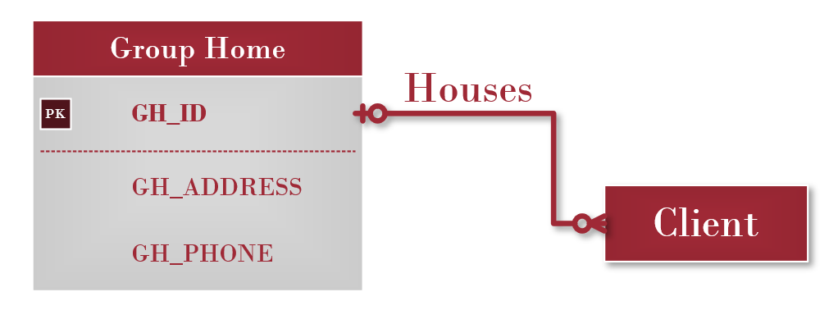
Group home table
Notes:
Justin

Slide 44
Group home table – Rules and Data
GH_ID | GH_ADDRESS | GH_PHONE
1 | 123 Some St. | Xxx-xxx-xxxx
2 | 456 Another St. | Xxx-xxx-xxxx
One group home can have many clients
One client can live in one group home
Notes:
Justin

Slide 45
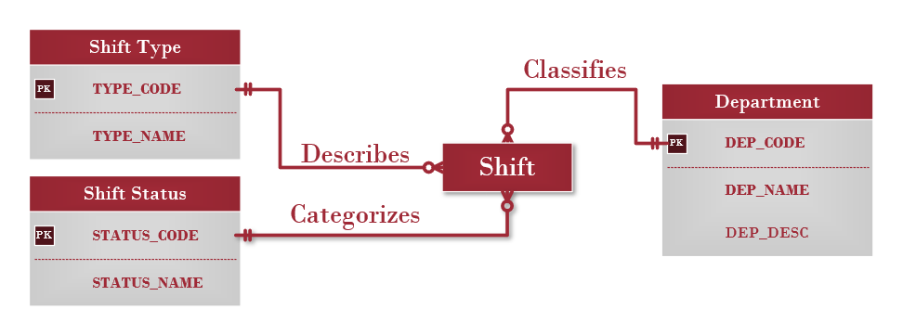
Lookup tables
Notes:
Justin

Slide 46
Conclusion
The system we are proposing sets out to meet all requirements set out by our client, Edenbridge.
Database management allows for a far greater degree of organization of the data being sent through the system.
Table & relationship structure in database creates a versatile system designed to ease transition.
Web interface establishes portability and creates incentive to maintain up-to-date information
Extended timeframe as trade off for minimal cost.
Notes:
Beryon
Touch on the adaptability of the tables. Only the essential fields required to calculate pay and schedules will be mandatory. As Edenbridge looks to expand the utilization of the new system, more fields can be used which will open up more options within software for calculations and UI.

Slide 47
Questions?
Notes:
Everyone

